Slide 1

PS-2 Customer Churn Prediction
using Machine Learning

Slide 2

KESHAV MEMORIAL INSTITUTE OF TECHNOLOGY
Accredited by NBA & NAAC, Approved by AICTE,
Affiliated to JNTUH, Hyderabad
3-5-1026, Narayanguda, Hyderabad-29.
Under the guidance of
Ms. SWARAJYA LAXMI
Assistant Professor
Department of Information Technology
Project Team Members Roll numbers
CH SRI SAI 19BD1A1213
K.Harsha Vardhan 19BD1A1226
N.Amith 19BD1a1232
Sk.Inthiyaz 19BD1A1245

Slide 3
CONTENTS
ABSTRACT
INTRODUCTION
SYSTEM REQUIREMENTS
UML DIAGRAMS
IMPLEMENTATION DETAILS
SCREENSHOTS
TEST CASES
CONCLUSION
REFERENCES

Slide 4
ABSTRACT
Customer churn analysis and prediction in telecom sector is an issue now a days because it’s very important for telecommunication industries to analyze behaviors of various customer to predict which customers are about to leave the subscription from telecom company.
So machine learning techniques and algorithm plays an important role for companies in today’s commercial conditions because gaining a new customer’s cost is more than retaining the existing ones.
This Project Focuses on delivering the Accurate results
by implementing the Algorithm or Classifier based on Data set

Slide 5
INTRODUCTION
Churn prediction means detecting which customers are likely to leave a service or to cancel a subscription to a service.
It is a critical prediction for many businesses because acquiring new clients often costs more than retaining existing ones.
Once you can identify those customers that are at risk of cancelling, you should know exactly what marketing action to take for each individual customer to maximize the chances that the customer will remain.

Slide 6
EXISTING SYSTEM
Despite the existence of many systems which can analyse the customer data and derive valuable insights from it like the factors affecting the customer churn, it becomes difficult to predict whether a particular customer would churn in the near future based on his characteristics in real time.
The existing systems use exploratory data analysis to understand the data and the companies have to take decisions based on these insights.
It is important for the companies to know specifically which customer is going to churned which customers are loyal customers so that the companies could take measures to retain the potential churners.
It is also important to use an efficient algorithm for this prediction.

Slide 7
PROPOSED SYSTEM
Though we can act upon the insights provided by the exploratory data analysis alone to take measures to retain the customers, much more effective measures can be formulated if the system is able to predict the particular customer who would potentially churn.
The predictive model needs to have a suitable machine learning algorithm to predict the churn value accurately. So it is important to check the compatibility of the algorithm being used by comparing the accuracy the model by using different algorithms.
Thus, the solution is to train various machine learning algorithms with the customer data and compare the results and choose the best algorithm for the customer churn prediction

Slide 8
SYSTEM REQUIREMENTS
The basic requirements to run our software in the system are called software requirements ,system which require the environment to develop the code which perform Prediction
Visual studio(or any other Ide to run the code)
Open cv
Sheets
HARDWARE REQUIREMENTS:
RAM : 4GB
Processor : dual core 2.4 GHz
Architecture : 64-bit x86, 32-bit x86 with windows/ linux
System : Desktop/ Laptop

Slide 9
FUNCTIONAL REQUIREMENTS
Login and Signup Module based on Hashing
Cookies store persistent login information for maintaining active sessions.
Prediction of Probability of churn value in Online Mode
Batch Processing for Different Data Set
Prediction of churn rate for given period
Helps to visualize best buying patterns and Statistics for Credit Score allocated to Customer
Helps in creating better strategies for customer drops

Slide 10
NON FUNCTIONAL REQUIREMENTS
Robustness
Seamless Connectivity
Real Time Processing
Security
Scalability
Reliability
Maintainability
Accessibility
Performance Monitoring

Slide 11
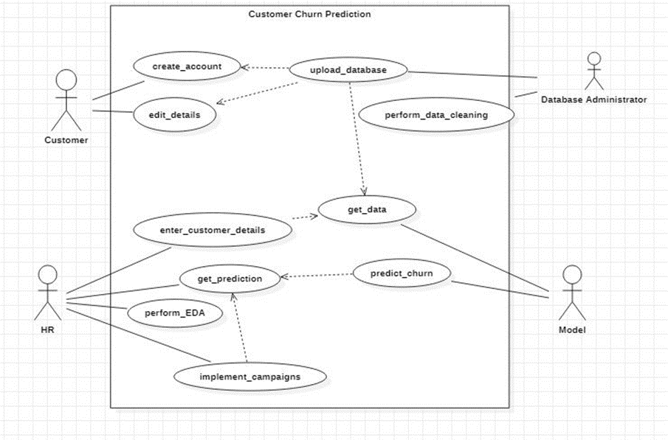
UML DIAGRAMS Use case Diagram

Slide 12
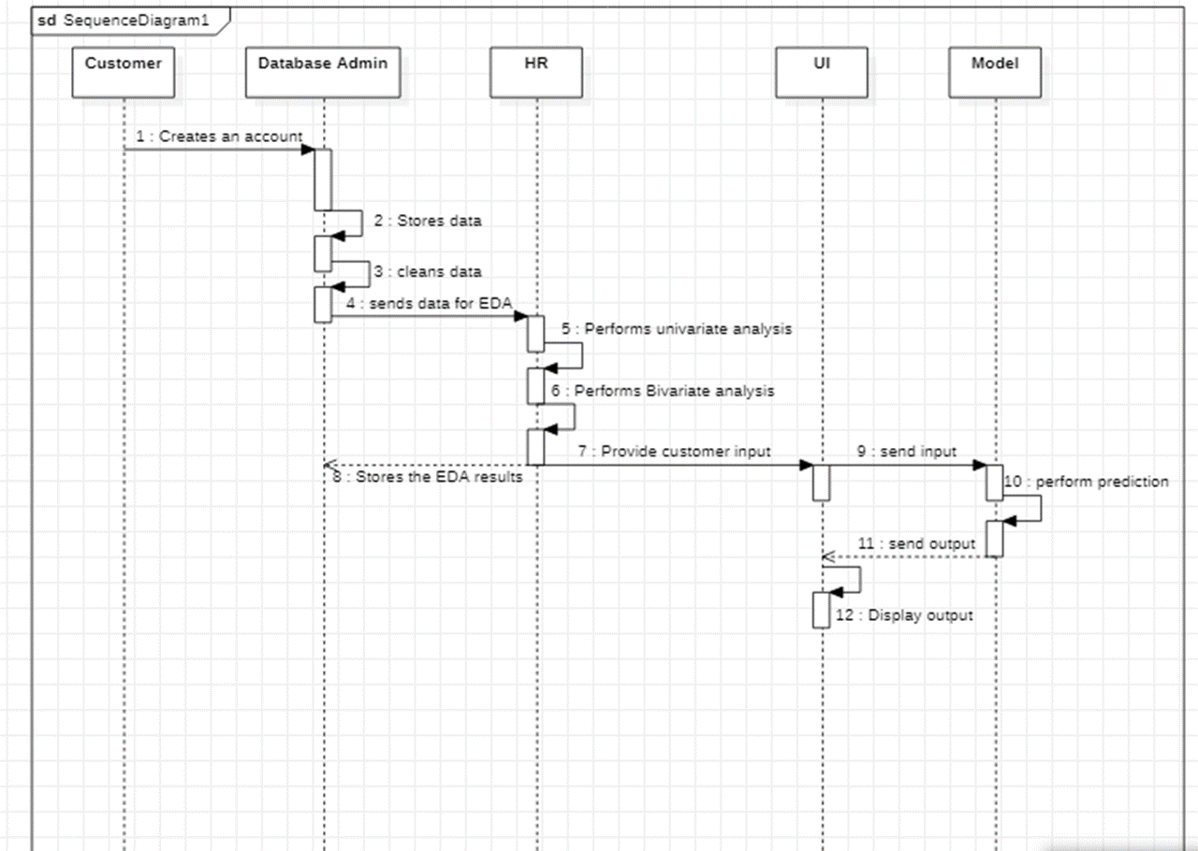
Sequence Diagram

Slide 13
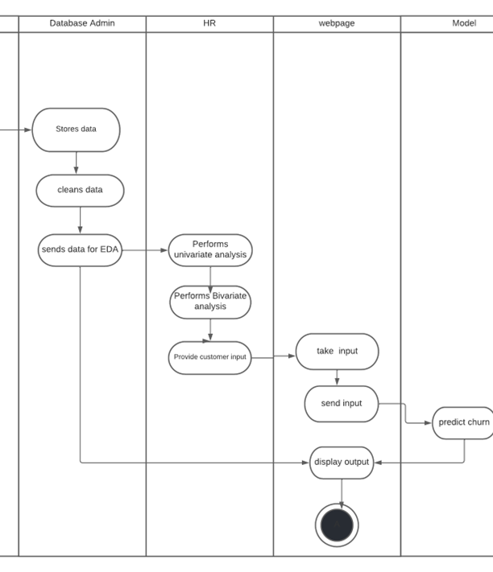
Activity diagram

Slide 14
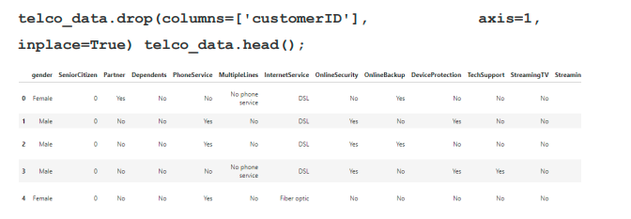
IMPLEMENTATION DETAILS
Module 1 - Data Preprocessing and Data Cleaning:
Ensure data quality and integrity by handling missing values, cleaning, transforming, and engineering features for analysis.

Slide 15
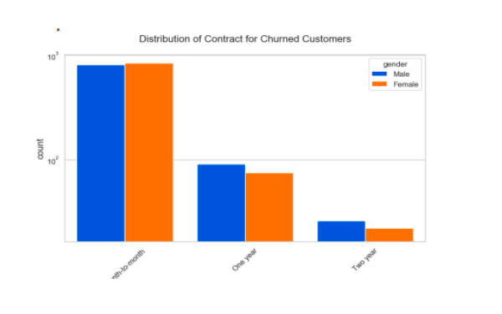
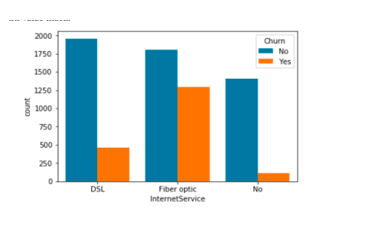
IMPLEMENTATION DETAILS
Module 2 - Data Exploration:
Gain insights from the customer churn dataset through descriptive statistics, data visualization, and exploratory data analysis, uncovering patterns, correlations, and outliers.

Slide 16
IMPLEMENTATION DETAILS
Data Exploitation includes Univariate and Bivariate Analysis
Module 3 - Interpretation of Models:
Develop predictive models, evaluate their performance, and interpret the important features contributing to customer churn, aiding in decision-making and understanding underlying factors.,which include classifiers :
Random Forest
Decision Tree
Catboost

Slide 17
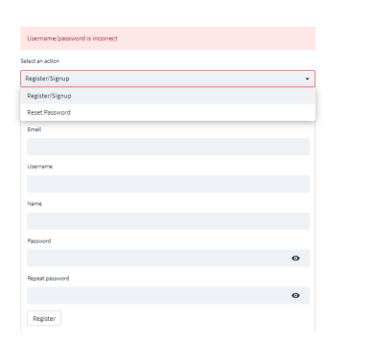
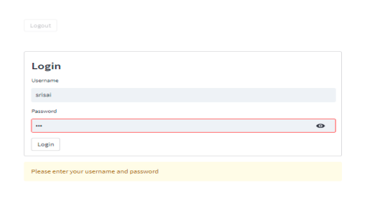
SCREENSHOTS
Fig1 Login Page and Signup Page

Slide 18
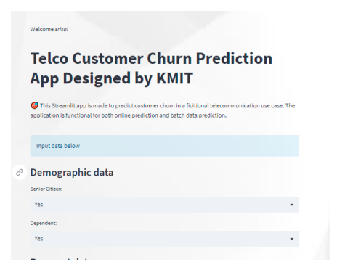
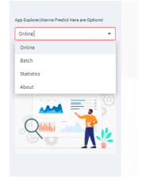
Fig3 Home UI

Slide 19
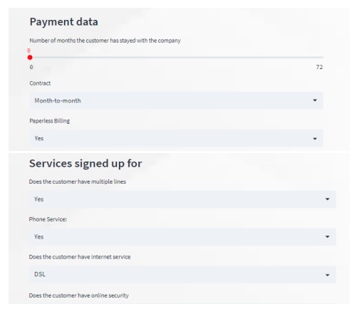
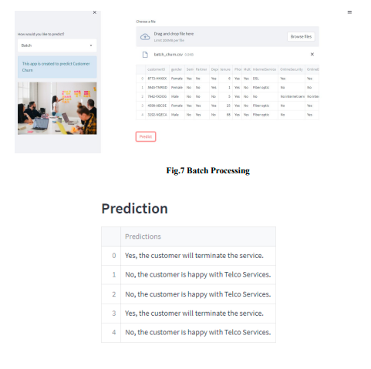

Slide 20
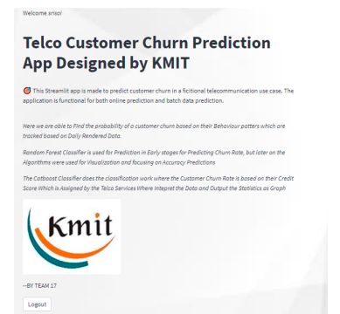
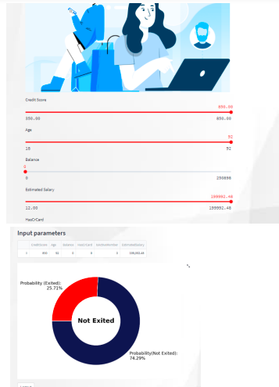

Slide 21
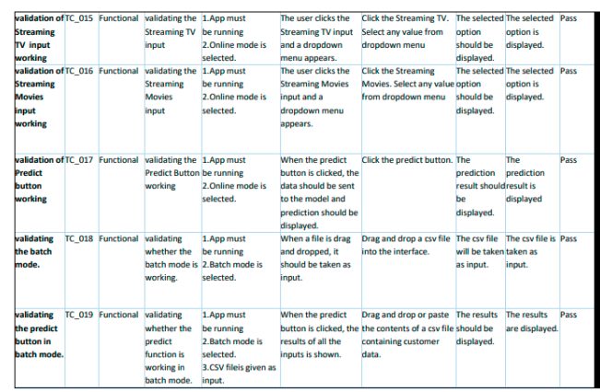
TEST CASES

Slide 22
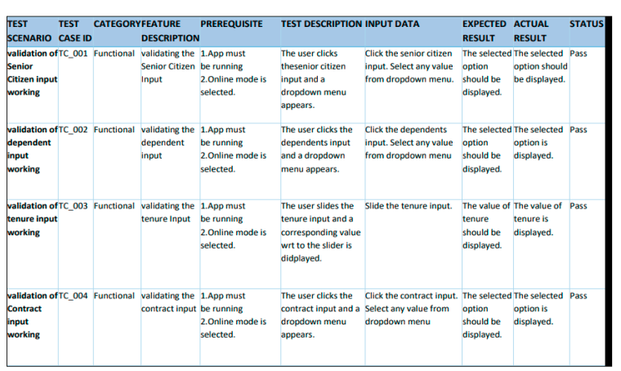
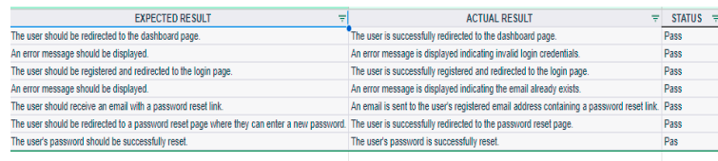

Slide 23
CONCLUSION
Customer churn prediction is vital for organizational success.
Retaining existing customers is cost-effective and requires less effort than acquiring new ones.
Effective mechanisms to analyze customer satisfaction and predict churn are crucial.
Model Evaluation Results:
Random Forest Classifier:
Accuracy: 94%
Identified behavior patterns and predicted churn effectively.
Catboost Classifier:
Accuracy: 92%
Credit score allocation to customer churn value showed significant results.

Slide 24
FUTURE ENHANCEMENTS
Understanding the Reason for Churn:
Knowing why customers churn enables better scheme formulation and Develop a system to identify exact reasons and compare competitor offers.
Personalized Recommendations:
Analyze churn reasons to recommend tailored plans to customers to Increase customer retentions.
Automatic Classifier Selection:
Develop a version to automatically choose the best classifier based on data type to Interpret data to optimize accuracy and enhance prediction performance.
User Interface Improvements:
Incorporate UI changes and Streamline navigation and usability for efficient churn analysis.

Slide 25
REFERENCE
Streamlit Authenticator GitHub repository. Available at: https://github.com/mkhorasani/Streamlit-Authenticator.
Retrieved in 2022.
Streamlit documentation. Available at: https://docs.streamlit.io/ Retrieved in 2021.
Introduction to Random Forest in Machine Learning. Available at: https://www.section.io/engineering-education/introduction-to-random-
forest-in-mac hine-learning. Retrieved in 2020.
CatBoost Classifier Python Reference. Available at: https://catboost.ai/en/docs/concepts/python-reference_catboostclassifier. Retrieved in 2021.
IEEE Xplore document: Churn Prediction using Machine Learning Algorithms. Available at: https://ieeexplore.ieee.org/document/9558876. Retrieved in 2021.

